Slide 1
How to Ask Question?
Copilot Research

Slide 2
Agenda
01.
Background
CONTENTS
02.
Example 1
03.
Example 2
04.
Summary

Slide 3











Background - Tech Stack
Github Copilot
Framework
Language
Github Copilot
Copilot Chat
IDE

Slide 4
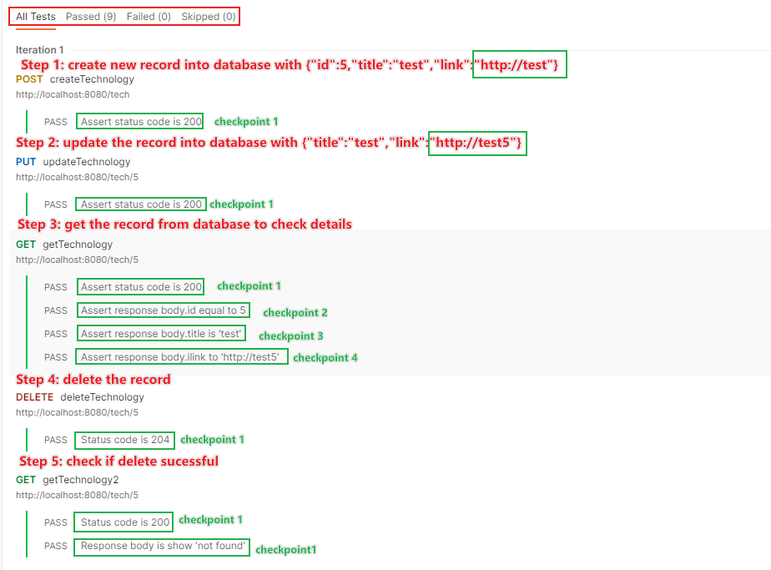
Background - Under Test
Requirements:
Tech Stack
java+gradle
testng:dataprovicer+factory
Test Logic
allAPIs in one test class
everyAPI in one test method
everyAPI dependsOn the previous one
Test Dependency
Test Data from postman json

Slide 5
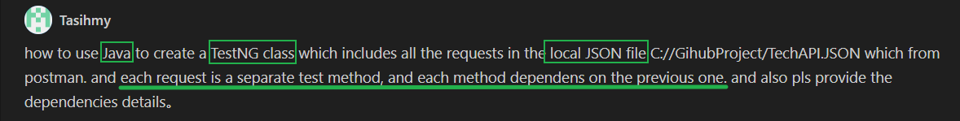
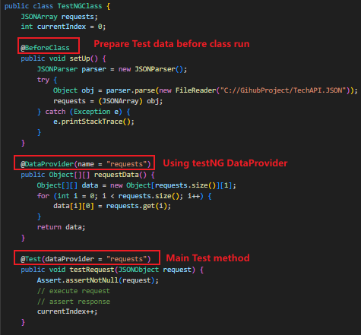
Example1.1-Single Test Case-local file
Low Usability
High Time-Consuming

Slide 6
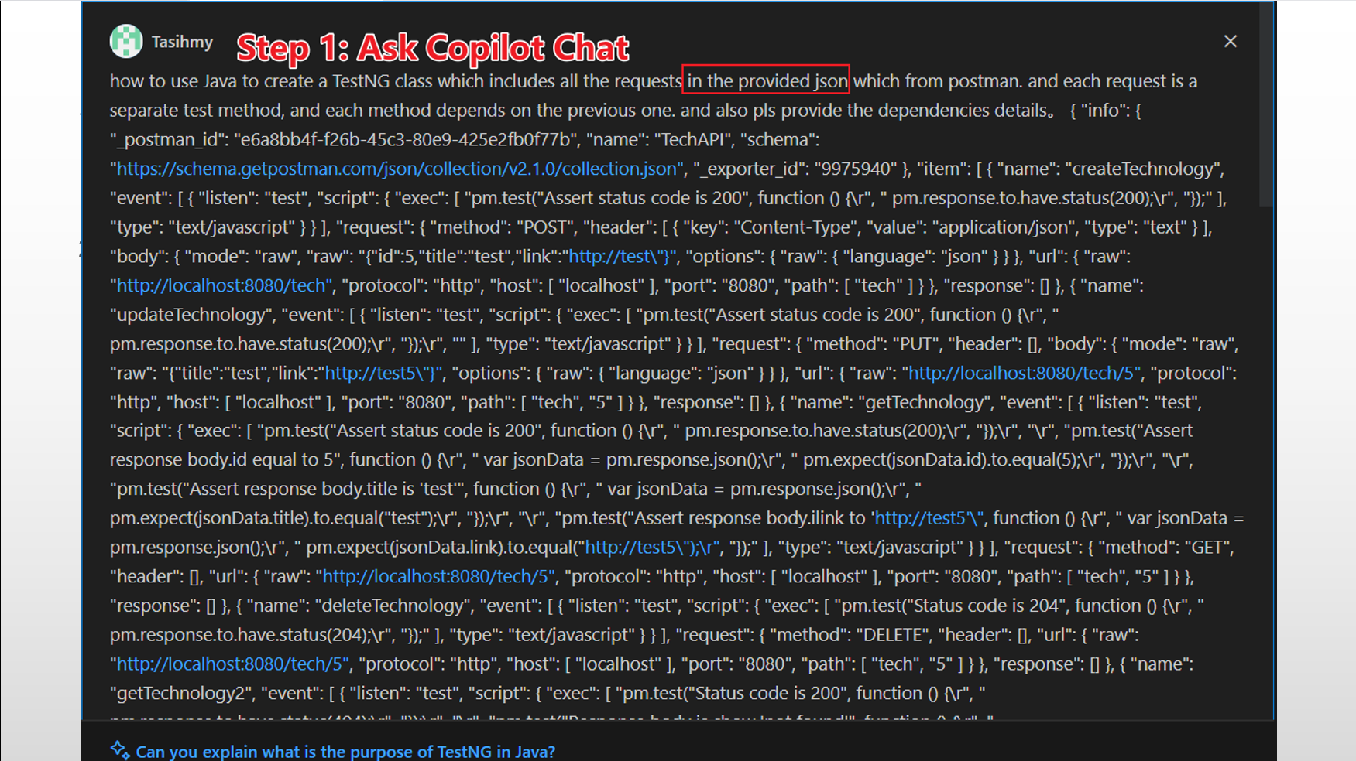
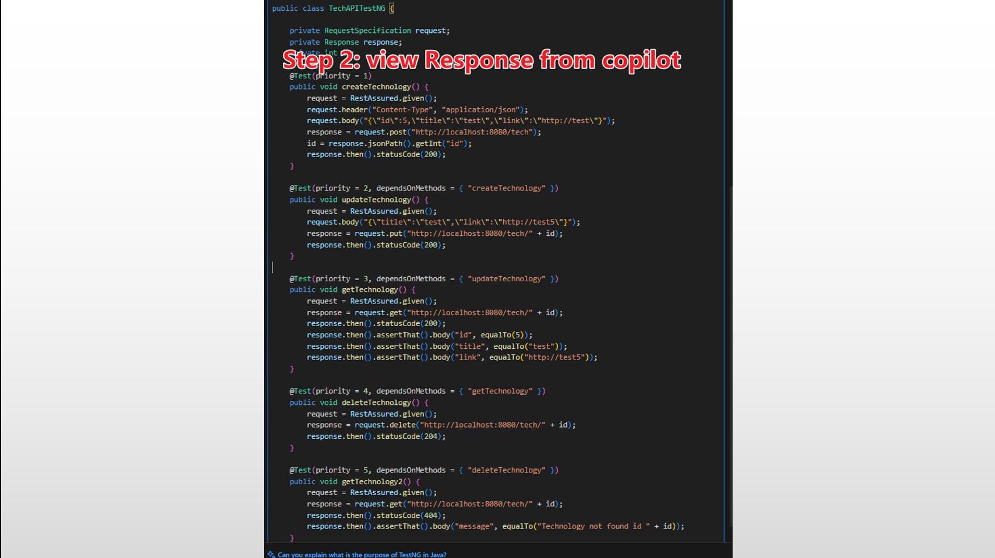
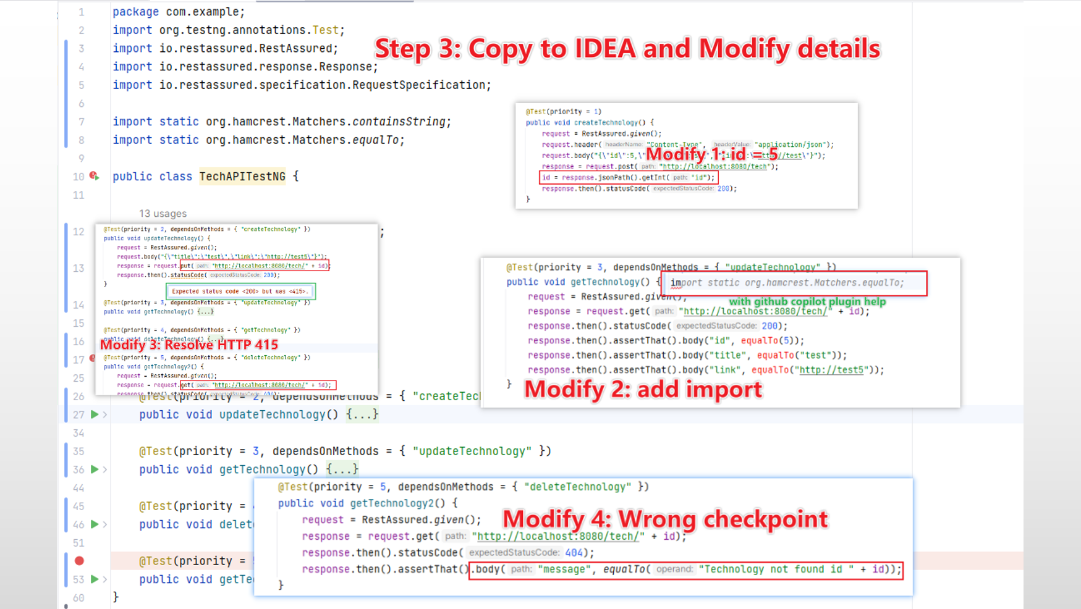
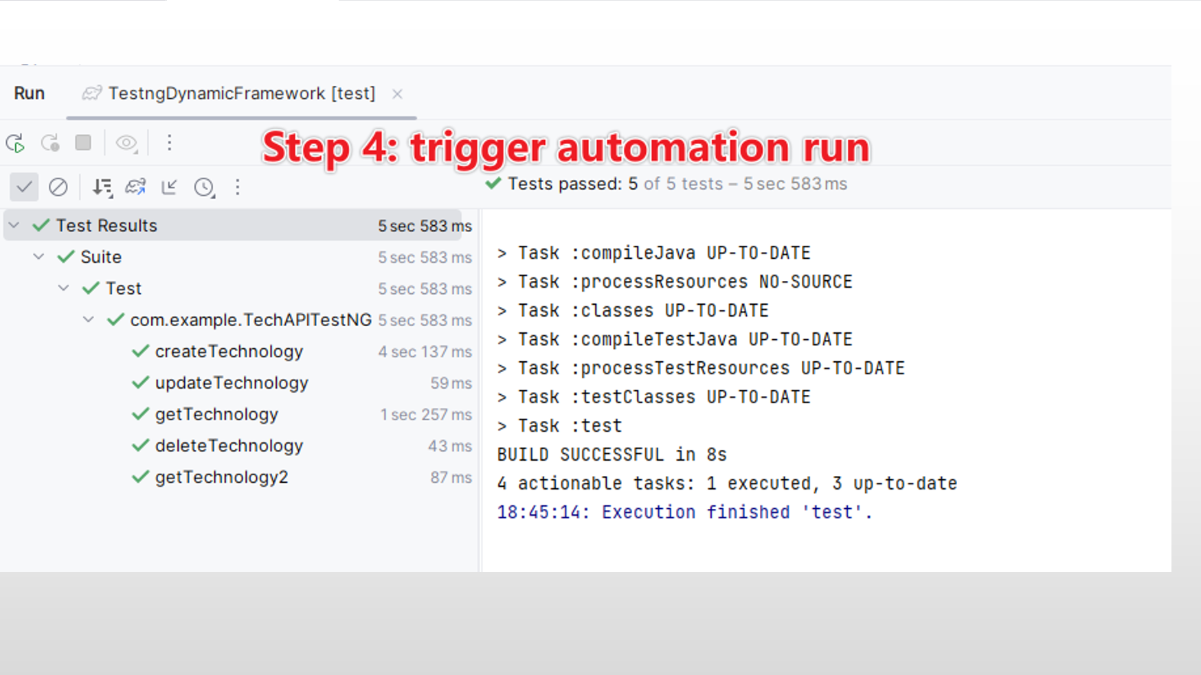
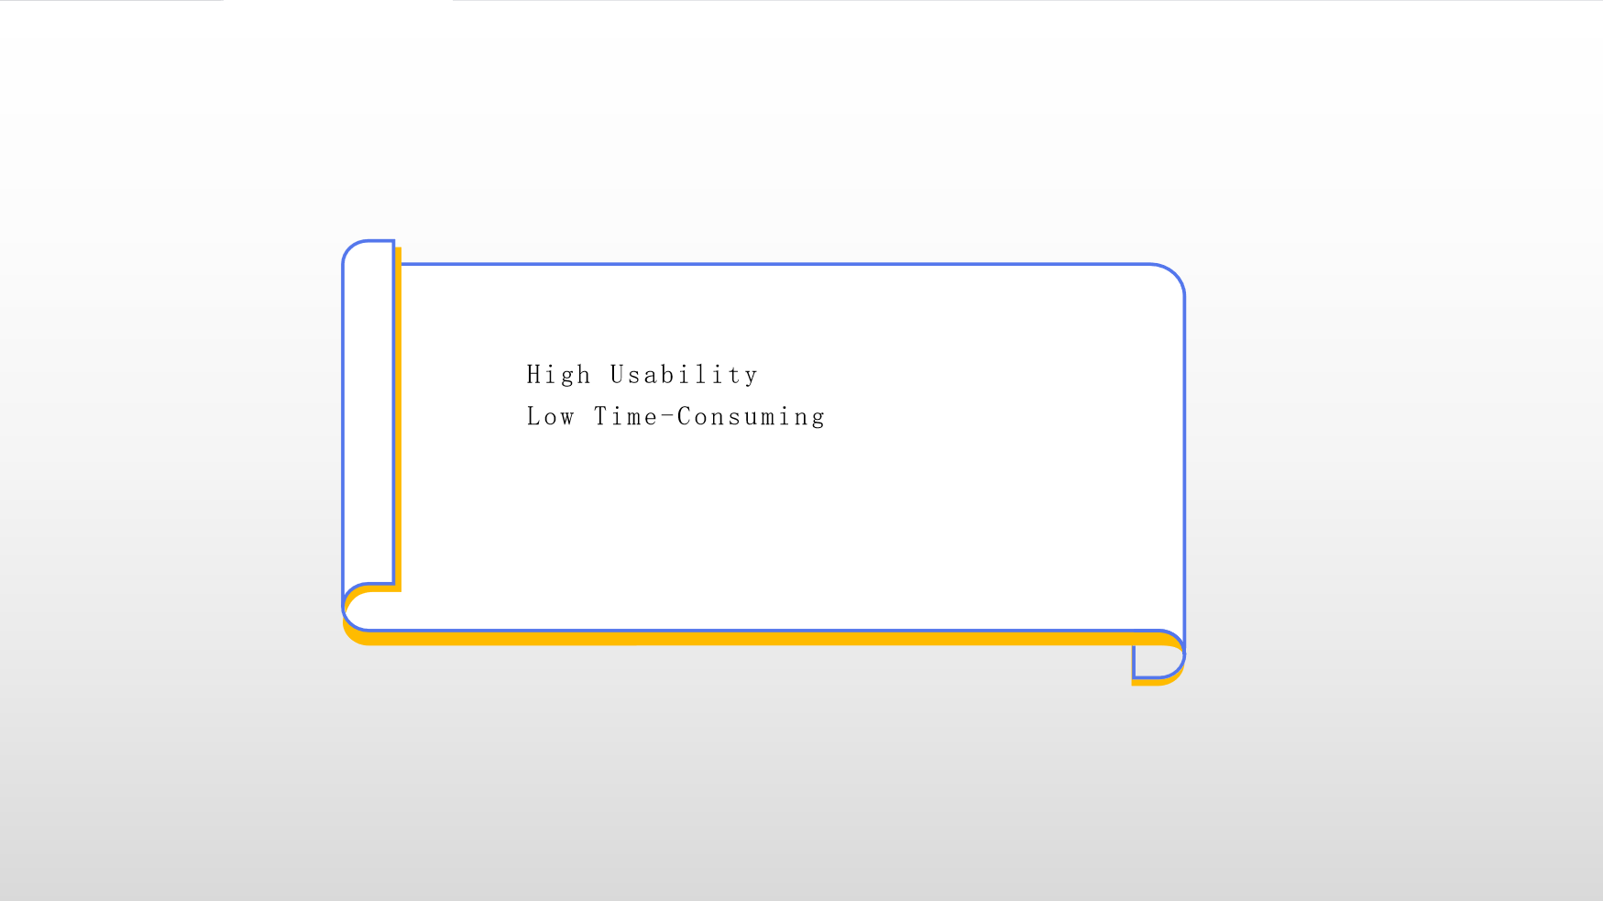
Example1.2-Single Test Case-json

Slide 7
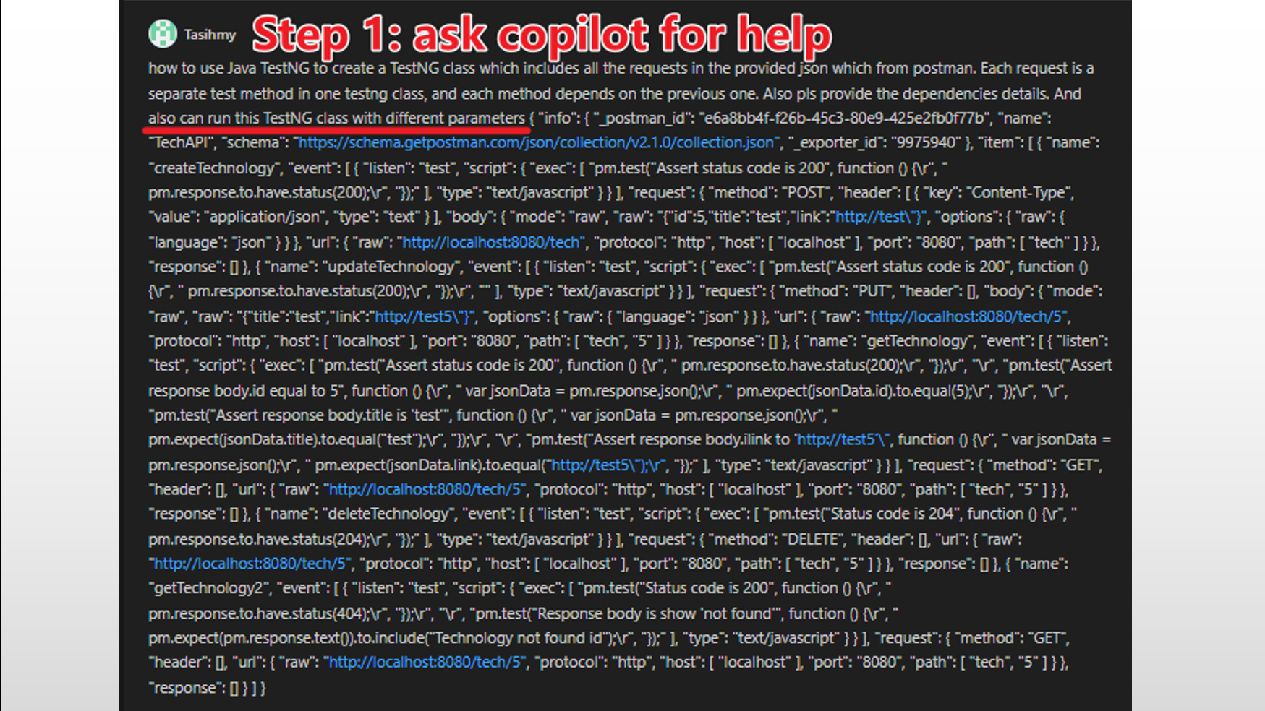
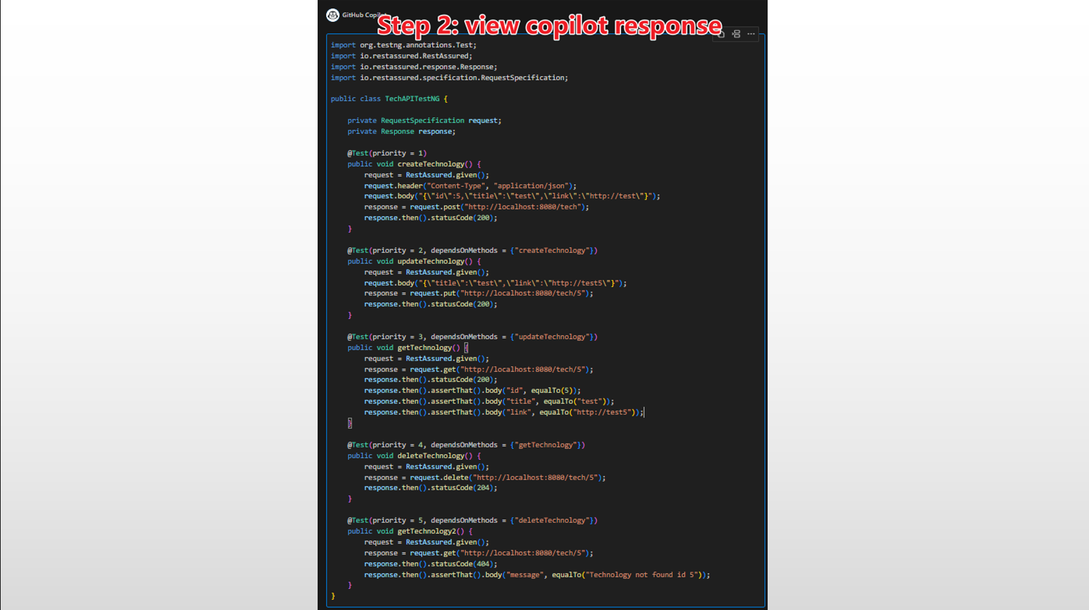
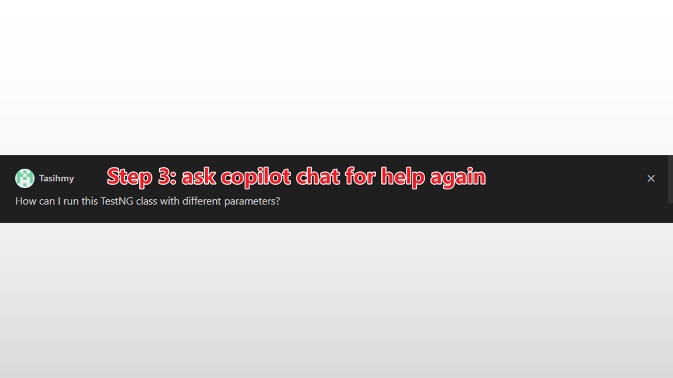
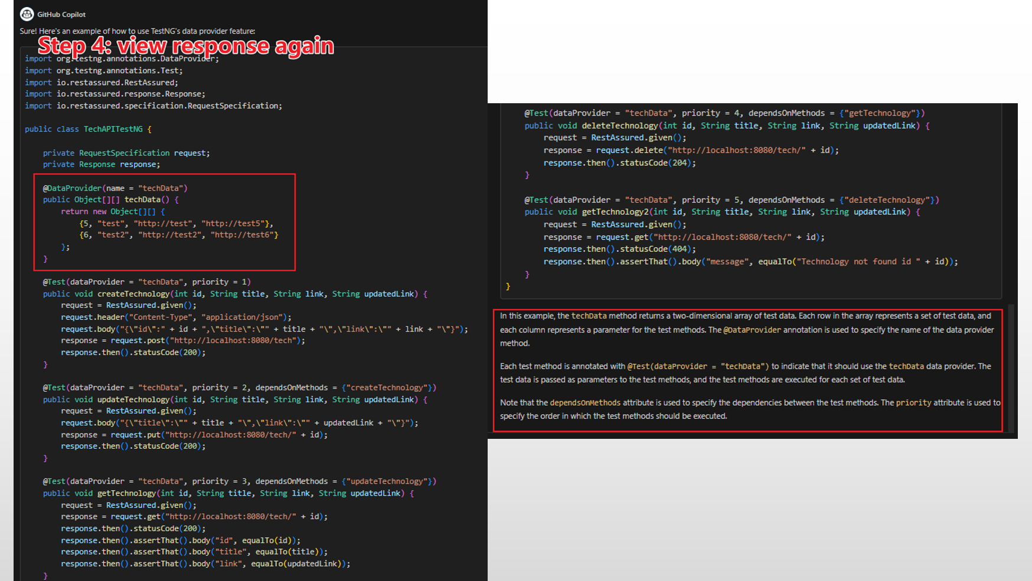
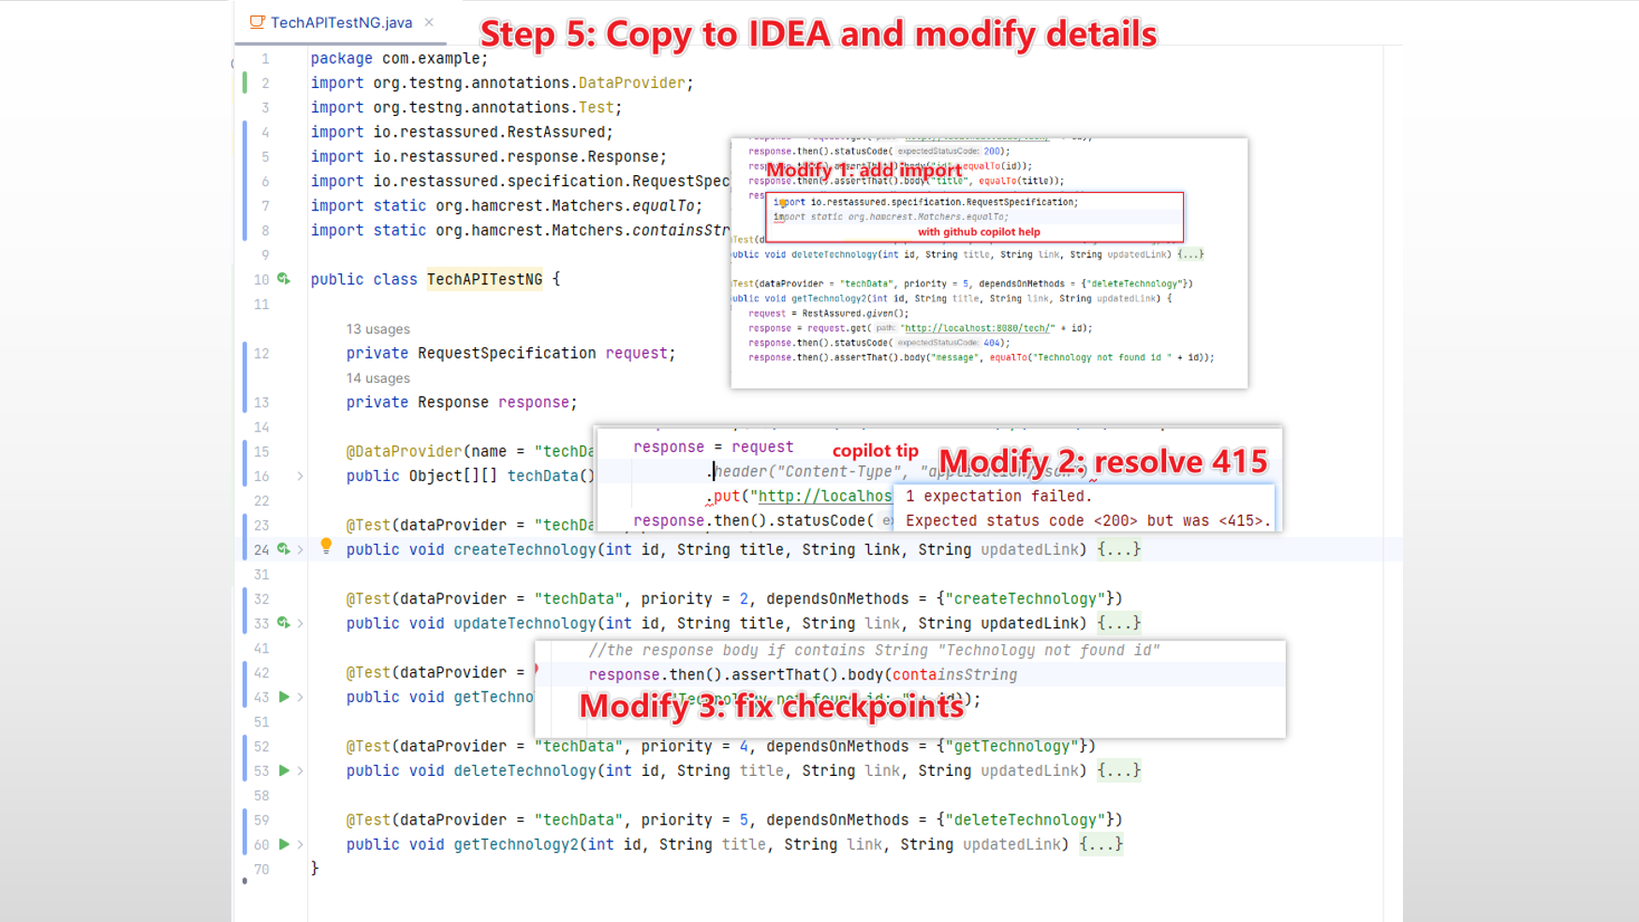
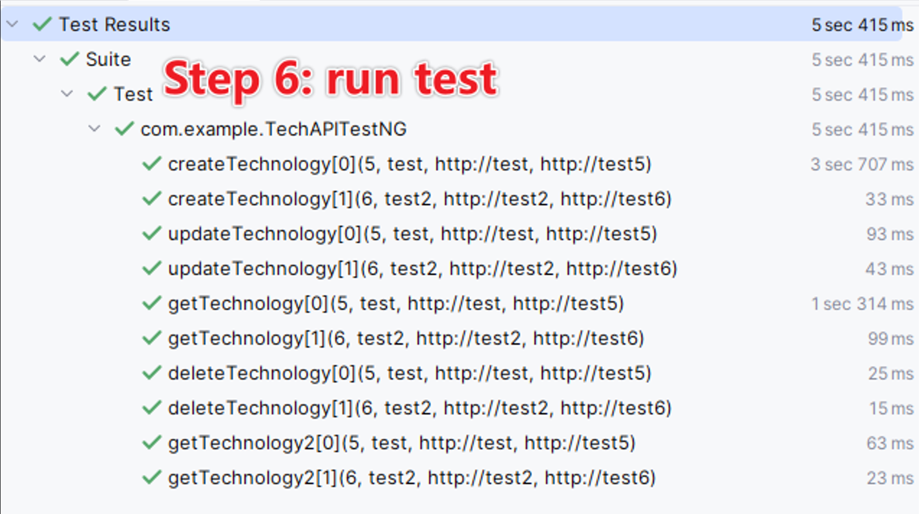
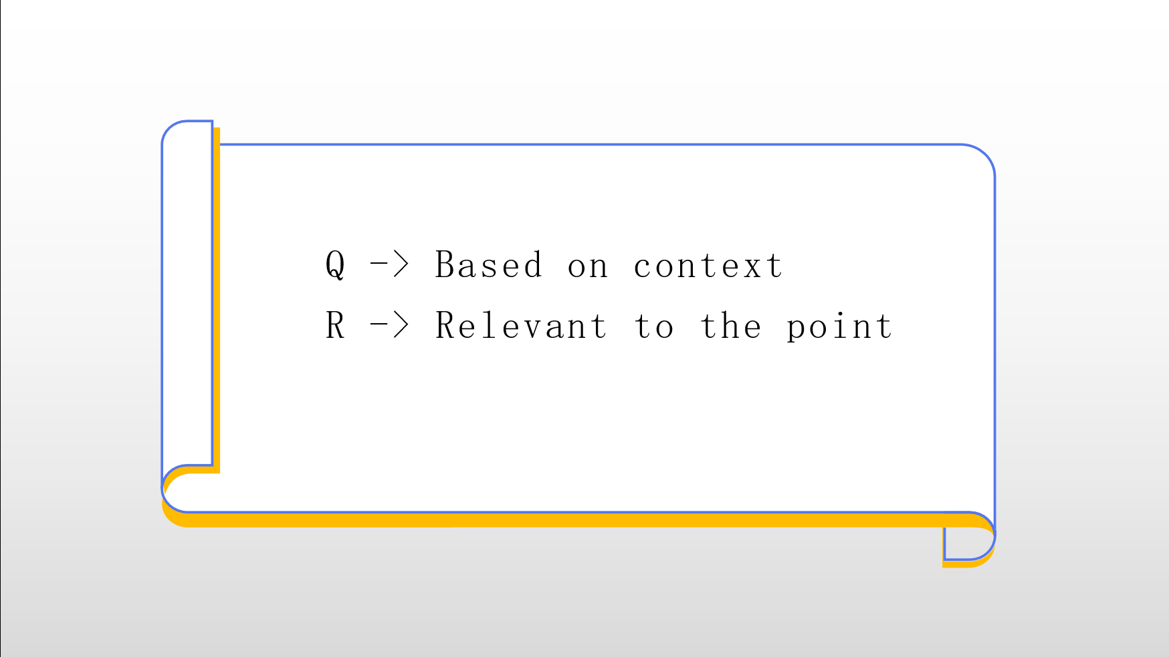
Example 2 - A set of Testcases

Slide 8
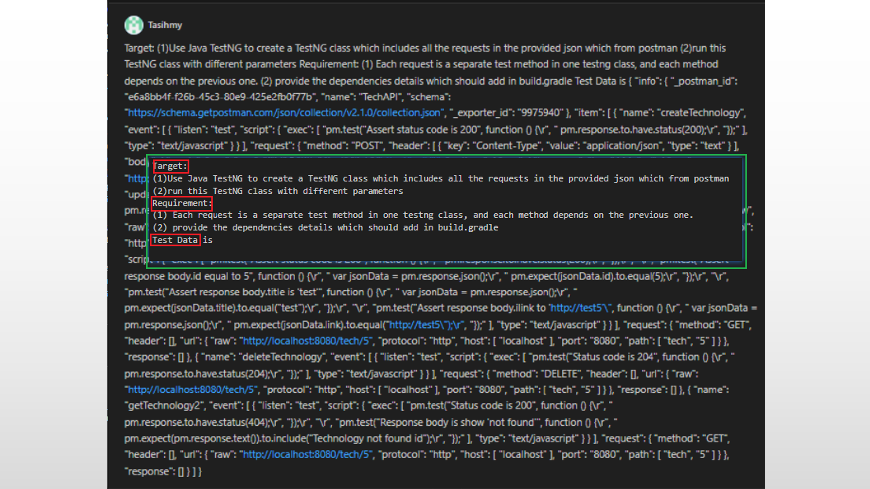
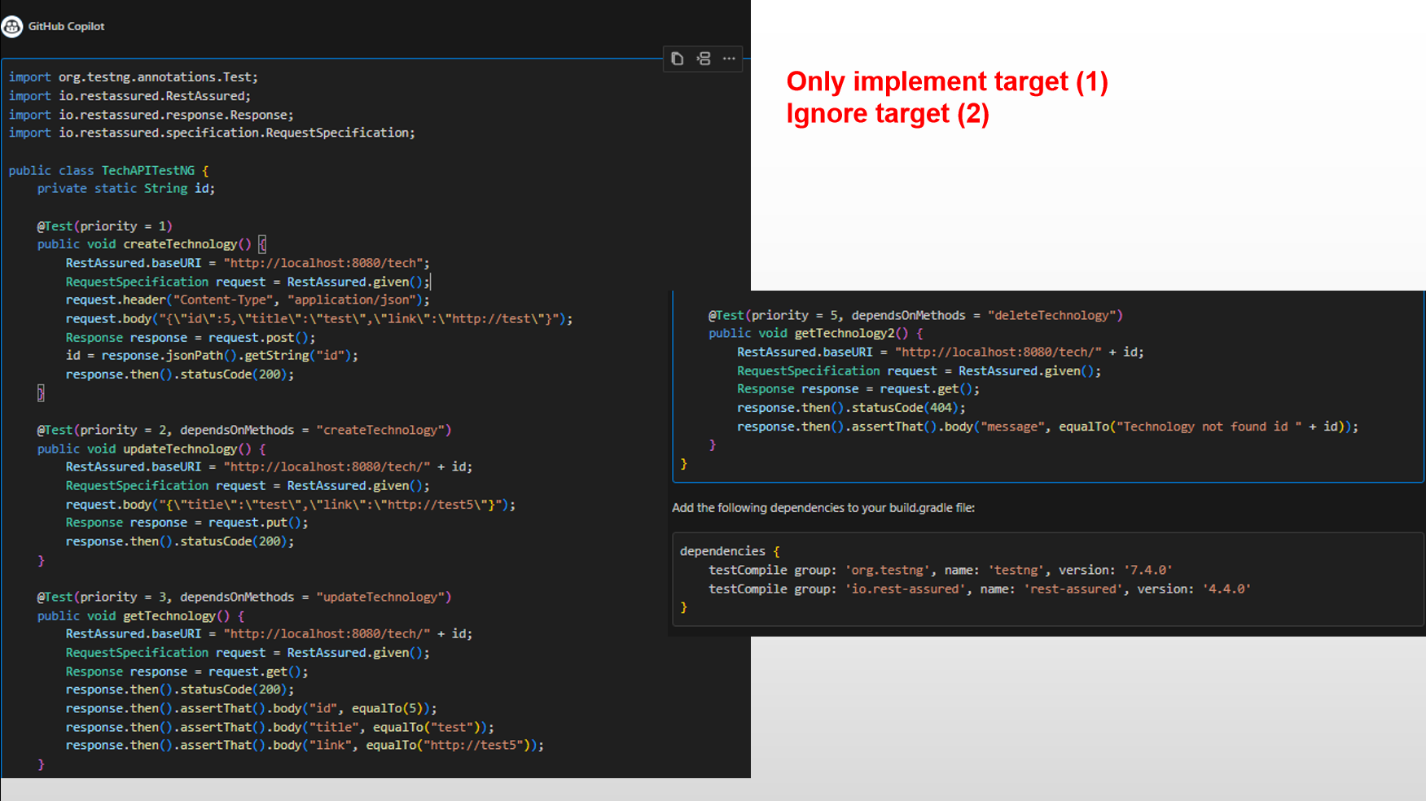
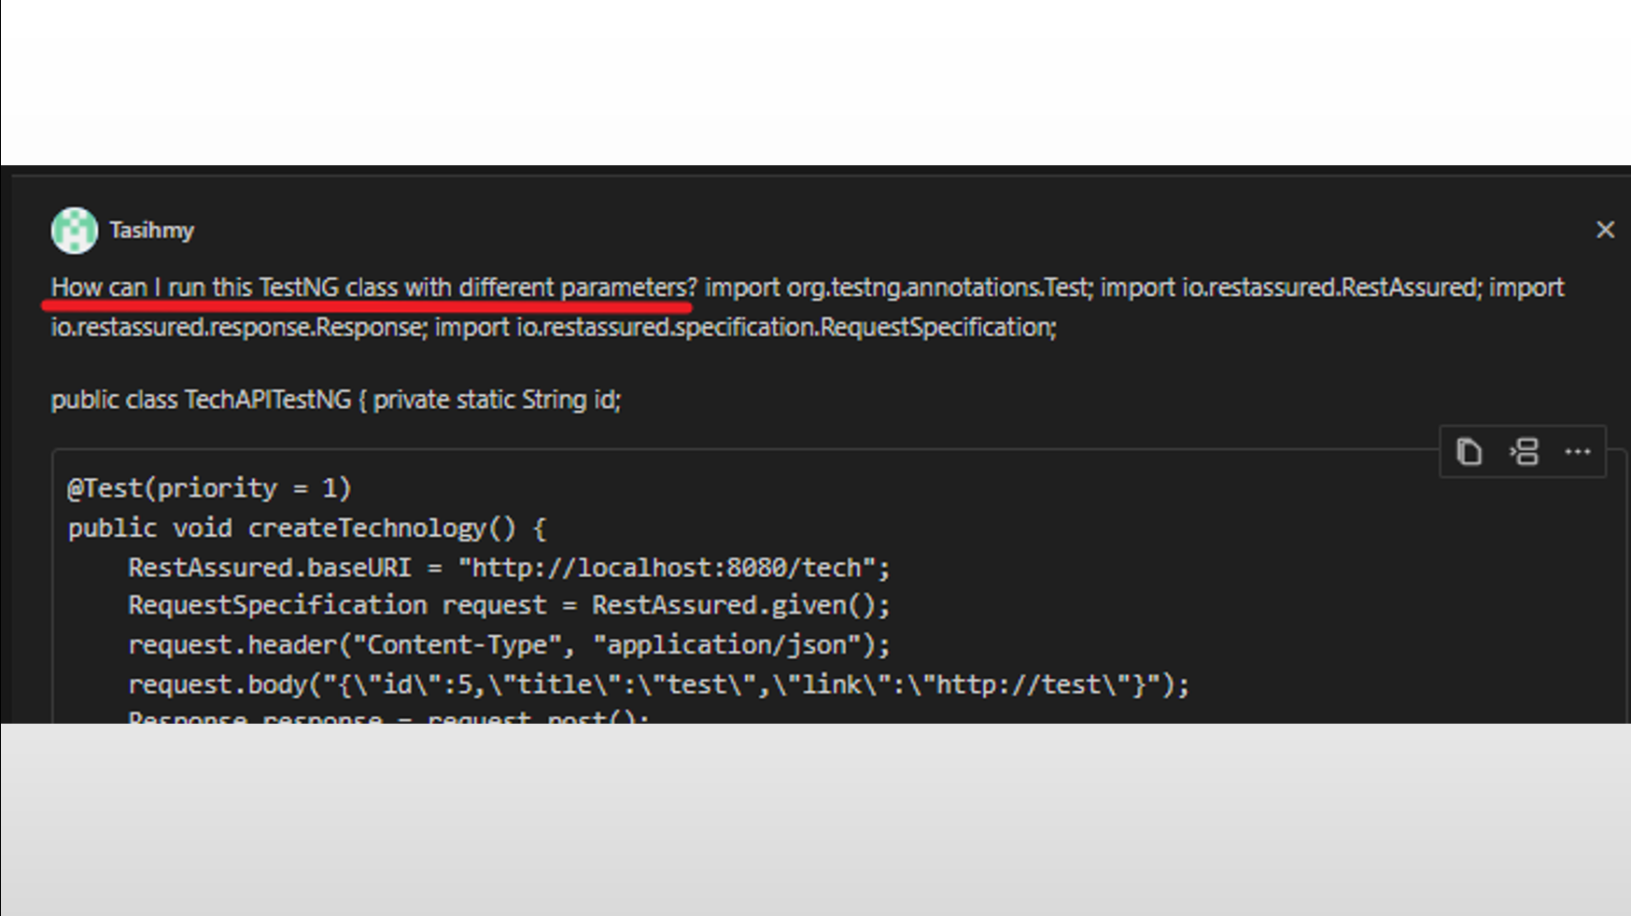
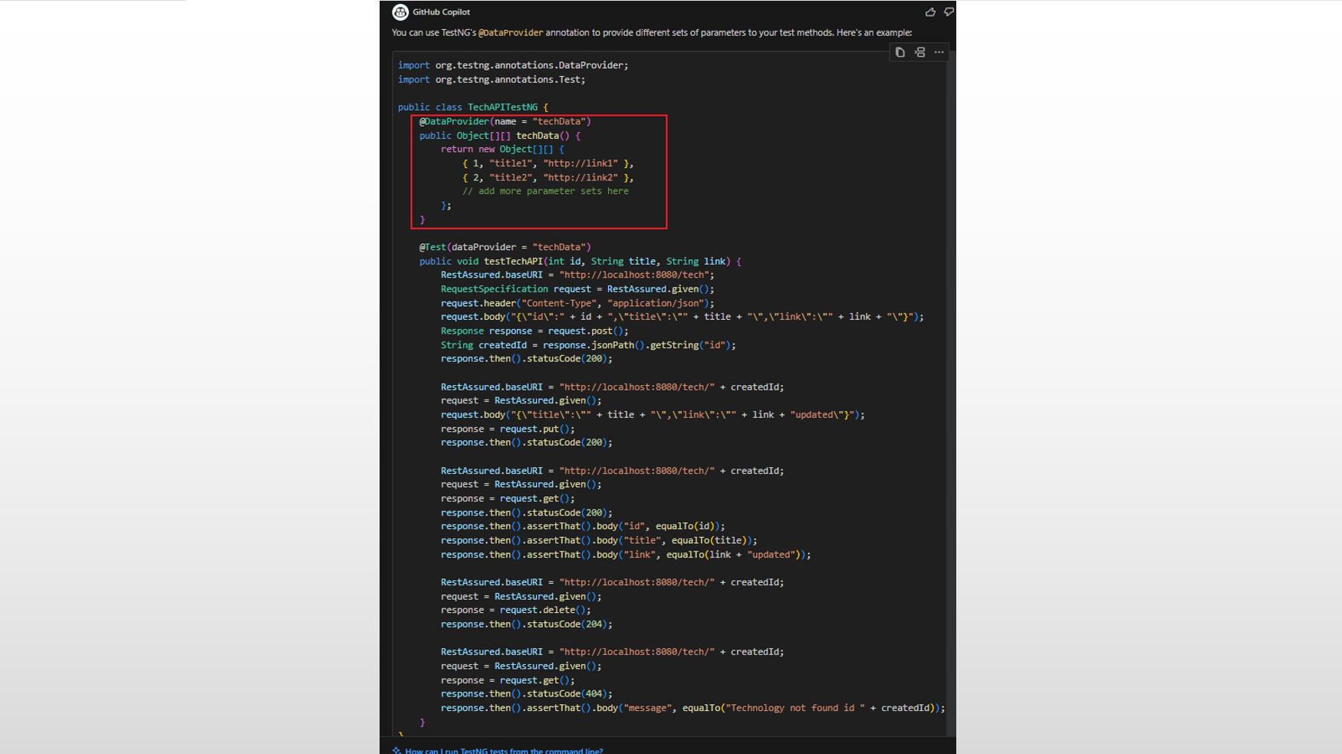
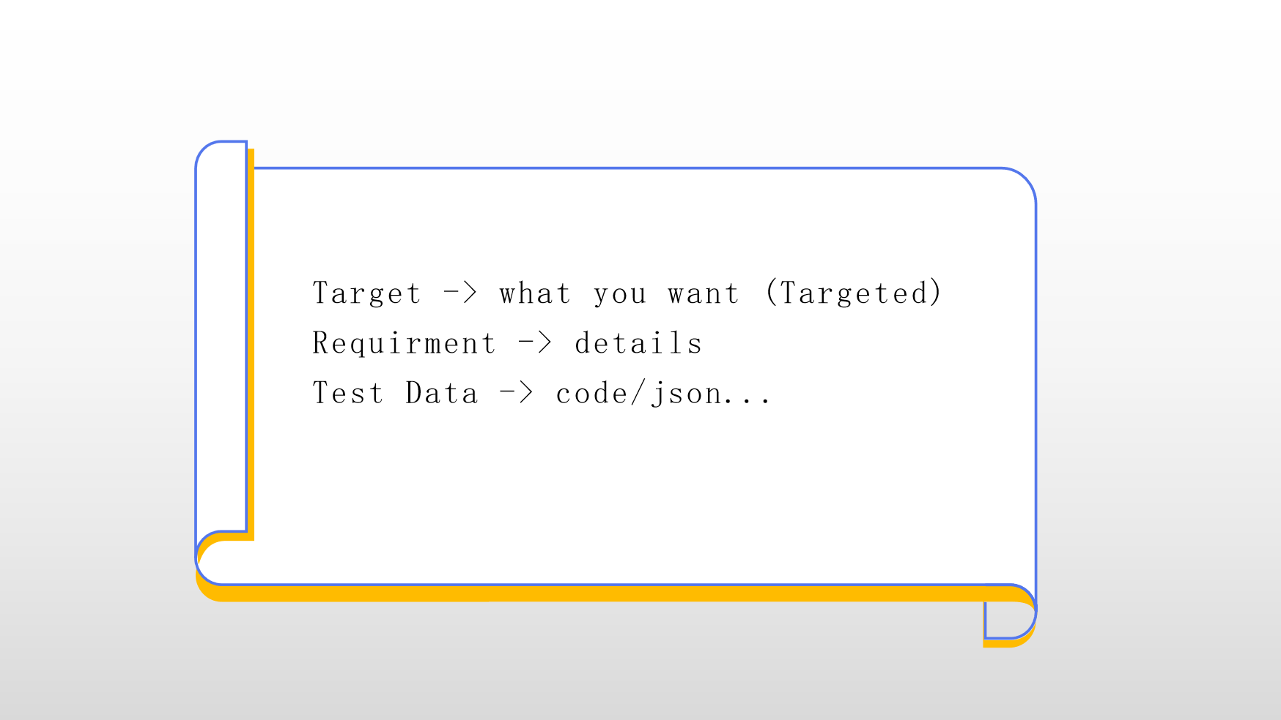
Additional - Another way to ask Copilot

